Slide 1

AI PROJECT
Sentiment Analysis on Twitter Data
Understand public opinion in real-time. Leverage social media for actionable insights. Discover knowledge from vast data.
Simran Tyagi(202410116100208)
Shefali Yadav(202410116100195)
Tanisha Jain(202410116100217)
Vishal Chaturvedi(202410116100248)

Slide 2




What is Sentiment Analysis?
Identify Opinions
Categorize emotions within text.
Three Categories
Positive, negative, or neutral sentiment.
Fine-Grained Analysis
Detailed sentiment levels like very positive.
Sentiment analysis identifies and categorizes opinions. It ranges from broad categories to fine-grained emotions. This technique applies across various industries.

Slide 3
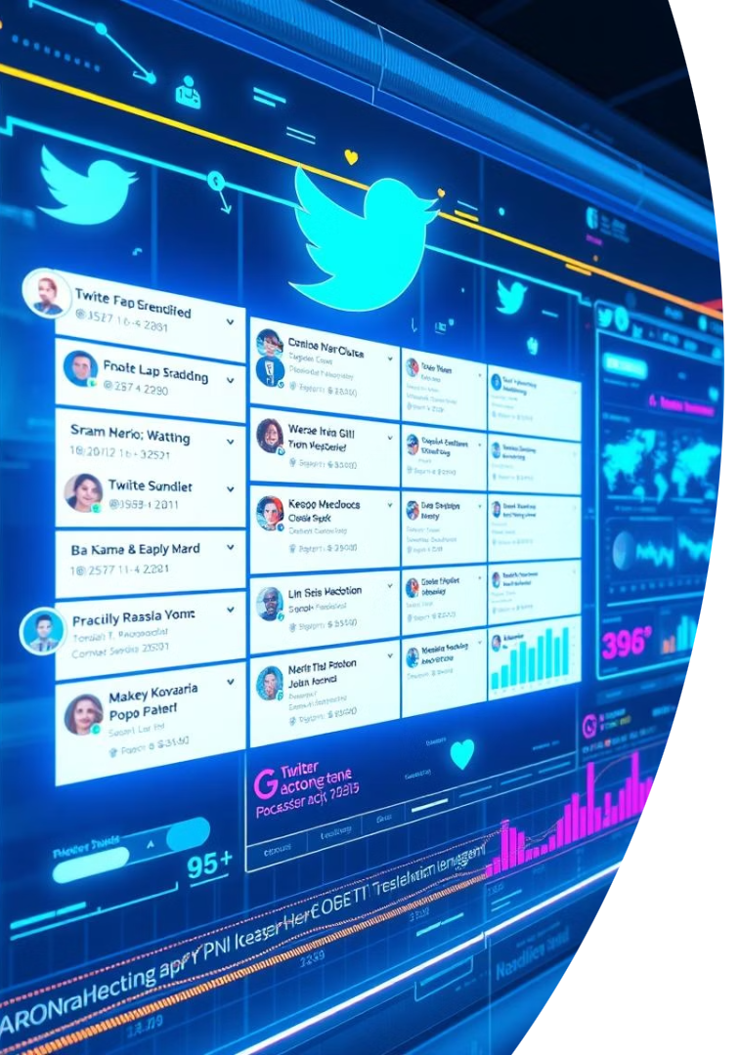
Why Twitter Data?
500M
Real-Time
Tweets Daily
Immediate Feedback
Massive volume for comprehensive analysis.
Insights reflect current events and trends.
Diverse
Broad Opinions
Represents a wide demographic spectrum.
Twitter provides real-time, vast, and diverse data. With millions of public tweets daily, it's a rich source. This accessibility enables comprehensive public opinion analysis.

Slide 4
Methods for Sentiment Analysis
Lexicon-Based
Machine Learning
Deep Learning
Uses sentiment word dictionaries.
Trains models on labeled datasets.
Utilizes transformers and neural networks.
Simple and transparent approach.
Learns patterns from examples.
Achieves up to 90% accuracy.
Methods range from simple lexicon-based systems to advanced deep learning. Hybrid approaches combine techniques. Accuracy can reach 90%, depending on data and chosen method.

Slide 5
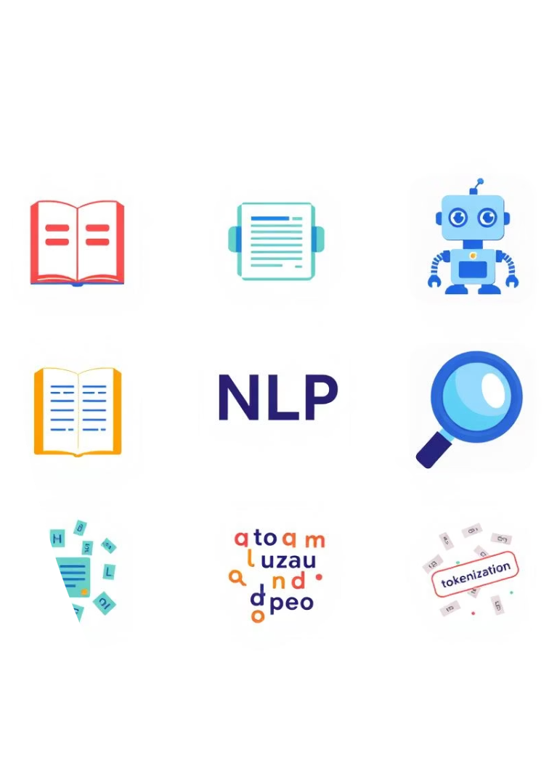



Tools and Technologies
NLTK
Natural Language Toolkit for processing text.
Transformers
Models like BERT for advanced understanding.
Text Classification
Assigning categories to text data.
Key tools include NLTK for foundational tasks. Transformers like BERT power deep learning models. Text classification and cleaning techniques are essential steps.

Slide 6
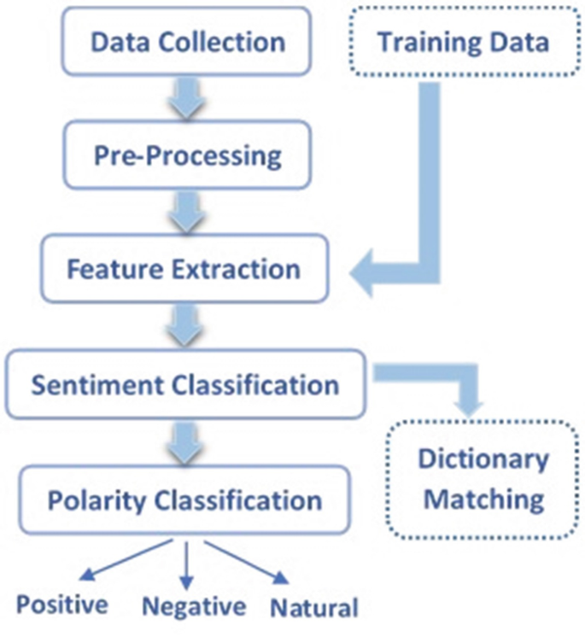
Flow Chart

Slide 7

Challenges in Analyzing Twitter Data
Informal Text
Sarcasm/Irony
Slang, abbreviations, and emojis present challenges.
Difficult for models to detect accurately.
Contextual Nuance
Spam/Bots
Requires deep understanding of language.
Filtering irrelevant data is crucial.
Twitter data poses challenges due to informal text and limited character count. Sarcasm, irony, and contextual nuances are hard to interpret. Filtering spam and bots is also necessary.

Slide 8





Use Cases
Brand Monitoring
Track customer opinions on products.
Financial Markets
Predict stock prices from news sentiment.
Public Health
Track sentiment for health campaigns.
Crisis Management
Identify and respond to emergencies.
Sentiment analysis supports brand monitoring and political analysis. It helps predict financial markets and manage crises. Public health campaigns also benefit from sentiment tracking.

Slide 9




Conclusion and Future Trends
Valuable Insights
1
Sentiment analysis offers deep understanding.
Improved Accuracy
2
Deep learning advances models.
Ethical Considerations
3
Address privacy and algorithmic bias.
Multimodal Analysis
4
Combining text, images, and audio.
Sentiment analysis delivers valuable insights, continuously improving with deep learning. Future trends include multilingual and multimodal analysis. Ethical considerations like privacy and bias remain critical.

Slide 10


